Slide 1
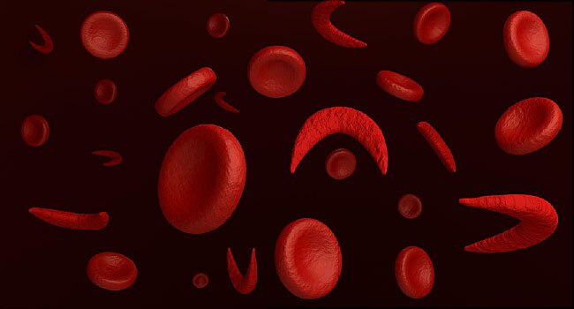
Making The Case For Palliative Care in Sickle Cell Disease
Canadian Pediatric Hematology/Oncology Network Conference
November 2nd, 2023
Ashley Allen, MD MSPH
Assistant Professor of Medicine
Duke University Hospital

Slide 2
Disclosure Slide
I have no relevant financial or non-financial disclosures to report related to the content of this presentation.

Slide 3
Objectives
Understand the key biopsychosocial factors in sickle cell disease and highlight their impacts on health-related quality of life.
Review and synthesize the literature in sickle cell disease related to palliative care, advance care planning and end of life care.
Outline potential roles for palliative care involvement in sickle cell disease.

Slide 4
Outline
Quality of Life/Psychosocial Aspects of SCD
Literature in SCD + Palliative Care
Role(s) For Palliative Care
Next Steps
Notes:
Presentation has been modified from one I gave at our PC Grand Rounds in 2020- have given this talk several times to different groups (hematology, HPM fellows, PC colleagues) since that time. Appreciate your honest feedback. My overarching goal is to partner with

Slide 5
Outline
Quality of Life/Psychosocial Aspects of SCD
Literature in SCD + Palliative Care
Role(s) For Palliative Care
Next Steps
Notes:
Presentation has been modified from one I gave at our PC Grand Rounds in 2020- have given this talk several times to different groups (hematology, HPM fellows, PC colleagues) since that time. Appreciate your honest feedback. My overarching goal is to partner with

Slide 6
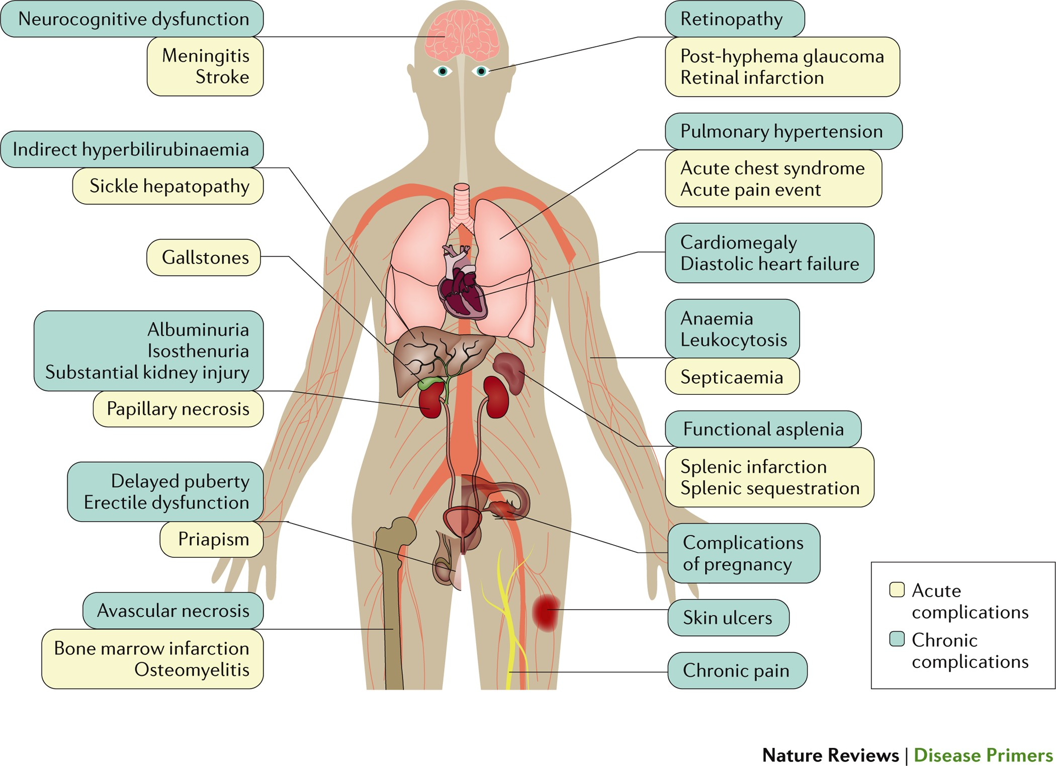
Complications in SCD
Notes:
SCD is a complex, multisystem condition characterized by acute and chronic complications. SCD is characterized by a remarkable phenotypic complexity. Common acute complications are acute pain events, acute chest syndrome and stroke; chronic complications (including chronic kidney disease) can damage all organs.
Advances in general medical care, early diagnosis and comprehensive treatment have led to substantial improvements in the life expectancy of individuals with SCA in high-income countries^{8,9} as almost all patients survive beyond 18 years of age¹³⁹. However, even with the best of care, life expectancy is still reduced by ∼30 years, routine and emergency care for individuals with SCD have great financial costs, the quality of life often deteriorates during adulthood and the social and psychological effects of SCD on affected individuals and their families remain underappreciated¹⁴⁰. Furthermore, most of these advances have not reached low-income countries¹⁴¹.
Complications of pregnancy include pre-eclampsia, intrauterine growth restriction, preterm delivery and perinatal mortality.
Approximately 10 percent of children with SCD will have a symptomatic stroke, which can cause learning problems and lifelong disabilities.

Slide 7
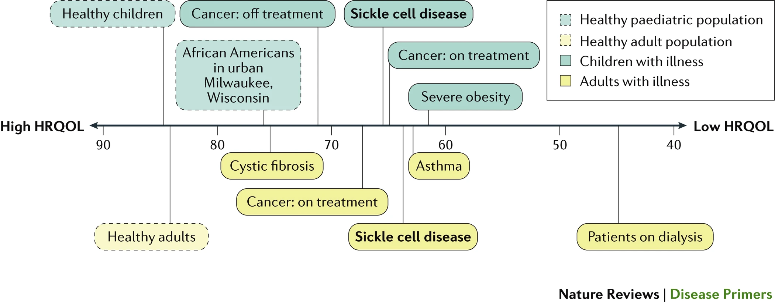
Quality of Life in Sickle Cell Disease
Notes:
Both adults and children with SCD have substantially impaired baseline HRQOL^{199,233} (Fig. 7). Compared with healthy individuals, individuals with SCD have impaired HRQOL in nearly every domain, especially within the areas of pain, fatigue and physical functioning^{234,235}. Adolescents and adults report poor sleep quality, moderate levels of fatigue and that sleep quality mediates the relationship between pain and fatigue²³⁶. The baseline physical functioning HRQOL domain of many individuals with SCD is worse than or comparable with that of individuals with other chronic diseases, such as cancer, cystic fibrosis or obesity²³⁷.

Slide 8
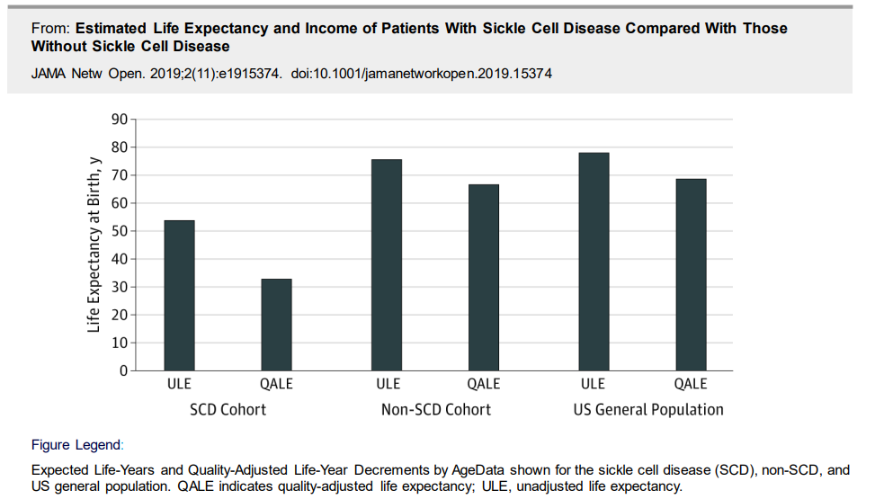
Quality of Life for Adults with SCD is poor

Slide 9
PISCES STUDY
Longitudinal cohort study of over 200 adult patients with SCD
HRQOL measured using Medical Outcome Study 36-SF-
8 domains including: physical function, physical role functions, emotional role functioning, bodily pain, vitality, general health, mental health and social function.
Participants completed daily pain diaries
3 variables calculated: mean daily pain, % days in crises, %utilization
Pain in Sickle Cell Epidemiology Study(PiSCES)
Smith WR, Penberthy LT, Bovbjerg VE, et al. Daily assessment of pain in adults with sickle cell disease. Ann Intern Med 2008; 148:94. Smith WR, McClish DK, Dahman BA, et al. Daily home opioid use in adults with sickle cell disease: The PiSCES project. J Opioid Manag 2015; 11:243.
Notes:
Pain in Sickle Cell Epidemology Study (PiSCES)- designed to understand the relationship b/w pain ad response to pain. Prospective study 232 adults with SCD – completed daily pain diaries x 6 months. Subscales are measured on a scale from 0 – 100 (with 0 being the worst and 100 the best score). The SF-36 is an indicator of overall health status

Slide 10
PiSCES Study: Results
55% of total days with pain
29% patients reported daily pain
Pain managed entirely at home on 38% of days
80% of those days included use of opioids
At least 10% used non-opioid analgesia for pain control
VOC utilizing medical care – 3.5% of days
Mean SCD pain highly predictive of poorer HRQOL
Pain is the rule, not the exception
Smith WR, Penberthy LT, Bovbjerg VE, et al. Daily assessment of pain in adults with sickle cell disease. Ann Intern Med 2008; 148:94. Smith WR, McClish DK, Dahman BA, et al. Daily home opioid use in adults with sickle cell disease: The PiSCES project. J Opioid Manag 2015; 11:243.
Notes:
In general, SCD patients experience a poor HRQOL. Except for mental health, the SF-36 subscale values were considerably lower than norms of the general US population. They reported a HRQOL that was equal to or poorer than patients with other significant chronic conditions in many domains. Similar to patients with SCD, until somewhat recently, patients with cystic fibrosis rarely lived until adulthood, marking this as a disease with significant sequelae and high mortality. It is interesting, then, to see that quality of life of adult survivors of this chronic disease, even though impaired, was comparable to national norms, and was generally far superior than that reported by adults with SCD.
For each subscale, mean SCD pain was highly predictive (p < 0.0001 for all subscales except p = 0.0396 for mental health). The more SCD pain a subject experienced, the worse the reported quality of life.

Slide 11
Sickle Cell Disease: The Pain Burden
Misperceptions:
1997 Survey: 50% of ED physicians and 23% of hematologists believed that SCD patients were addicted to opioids
2005 Survey: 86% of teaching hospital physicians did not believe that patient’s own self report was the best indicator of their actual pain
Words matter and can perpetuate bias:
Sickler
Pain Crisis
Frequent flier
Drug seeker
Shapiro BS, Benjamin LJ, Payne R, Heirich G. Sickle cell-related pain: perceptions of medical practitioners. J Pain Symptom Manage. 1997;14:168-174.

Slide 12
Sickle Cell Disease: The Pain Burden
Frequently delayed
SCD pts wait 25–50% longer in the ED¹
Often undertreated or inappropriately managed² --> “pseudo addiction”
Frequency of VOC:
1/3 = none for a year, 17% = >3
33% 30-day rehospitalization rate
Length of hospitalizations: 9-11d (adults) and 4-5d (peds)⁴
Physical exam findings often absent → gold standard is patient report
Estimated 30% - 40% adolescents and adults with SCD suffer from chronic pain
Recurrent pain → altered brain network connectivity → affects response to treatment
Haywood et al, 2013
Solomon et al, 2008
Colombatti et al, 2022
Ballas et al, 2007
Notes:
NHI report from 2014. Acute pain events usually affecting the extremities, chest and back are the most common cause of hospitalization for individuals with SCA. However, the majority of such events are managed at home with NSAIDs or non-prescription oral opioid analgesics without the involvement of the health care provider. The pathophysiology and natural history of acute pain events are complex, and treatment is suboptimal¹⁶³. Individual personalized protocols for outpatient and inpatient pain management improve quality of life and decrease hospital admissions. The treatment is guided by the severity of pain, which is generally self-reported using pain severity scales. hen home management with oral analgesics, hydration and rest is ineffective, rapid triage with timely administration of opioids is recommended. Initial treatment in a day unit compared with an emergency room drastically decreases hospitalization¹⁶⁷. Initiation of treatment for emergency room patients with SCD is often markedly delayed, with patients with SCD waiting 25–50% longer than patients without SCD with similar pain acuity.
The incidence of painful episodes requiring hospital admission is estimated once a year for the whole group of patients with
SCD, but may vary highly between and within individual patients. Approximately 5% of the patients with SCD are re-
sponsible for more than a third of all hospital admissions with vaso-occlusive crises.
PE findings: erythematous, swollen, tender superficial bony areas (sternum, spine, ribs, wrists). Nonspecific = tender abdomen.

Slide 13
Sickle Cell Disease: The Psychosocial Burden
High levels of associated stigma → generational
Emotional marginalization, depersonalization, disfranchisement
Financial Toxicity
Decreased workplace productivity, educational attainment, difficulty w/ daily household activities
Poor coping skills
Impaired neurocognitive function:
Decreased processing speed
Difficulty in executive functioning
Impaired social functioning in peer/spousal relationships
Impaired sexual functioning
Martin et. al, 2020
Barbarin et al, 1999
Osunkwo et al, 2019
Rizio et al, 2020
Notes:
Oftentimes, these patients feel that the medical community is less than compassionate and is, at best, tolerant.2 Patients with SCD may experience emotional marginalization, amplification in depressive moods, and expressed helplessness and hopelessness.7
These biopsychosocial factors can culminate in older adolescents as social anxiety and manifest as anger and low expectations; feelings of disfranchisement will result in limited productivity in the adult workforce with resultant dwindling expectations from medical and lay communities.8,9 Indeed, attitudes of the caregiver toward patients with SCD have been reported to contribute to the undertreatment of sickle cell–related pain.1
“Processing speed is an area of relative weakness compared to healthy siblings, which suggests that slowed processing is a result of SCD, although the precise mechanism remains unclear,” the researchers said.
Participants with sickle cell disease also had impaired executive function. The results showed the SCD patients had difficulties in their ability to inhibit impulses, initiate new tasks, remember newly presented information, plan and organize their thoughts and behaviors, and organize materials in order to complete a task. They also had difficulty controlling their emotions. These impairments on executive functioning seemed to be linked, at least in part, to depression, the researchers said.

Slide 14
Sickle Cell Disease: The Mental Health Burden
Frequently under-recognized/under-treated
27.6% of SCD patients with comorbid depression, and 6.5% with anxiety
Depressed patients had pain on more days than non-depressed patients (mean pain days 71.1% vs 49.6%)
Depressed patients had higher mean pain, distress from pain, and interference from pain on non-crisis days
Anxious patients had more pain, distress from pain both on non-crisis and crisis days, and used opioids more often
Associated with:
Greater pain sensitivity
Increased health care utilization
Increased somatic symptoms
Sleep disturbance
Levenson JL, McClish DK, Dahman BA, et al. Depression and anxiety in adults with sickle cell disease: The PiSCES Project. Psychosomatic Medicine. 2008;70:192-196.
Notes:
Baseline data including PHQ for diagnosis of depression and anxiety
Patients completed diary for up to 6 months noting pain intensity, distress, interference, ongoing pain crisis, opioid and medical care utilization
Very common (in at least one-third of individuals with SCD) comorbidities identified using screening questionnaires are depression and anxiety^{224,225}. Depression and anxiety are associated with greater sensitivity to pain²²⁶ and greater health care utilization²²⁷. Depression is also linked to sleep disturbance²²⁸ and, in general, might be under-recognized and undertreated in individuals with SCD.

Slide 15
Sickle Cell Disease: A Study in Inequity
Farooq F, Mogayzel PJ, Lanzkron S, Haywood C, Strouse JJ. Comparison of US Federal a nd Foundation Funding of Research for Sickle Cell Disease and Cystic Fibrosis and Factors Associated With Research Productivity. JAMA Netw Open. 2020;3(3):e201737

Slide 16
Sickle Cell Disease: A Study in Inequity
A Fraught History
Inadequate funding for research
Structural and interpersonal racism & stigma within healthcare system → distrust, stress, avoidance of care
“Sicklers” → Depersonalization
“Drug seekers” → perceived as opioid dependent at 2x rate of other pts with chronic non-malignant pain
Notes:
Cystic fibrosis affects one third fewer Americans than SCD but receives 7 to 11 times the research funding per patient, which results in disparate rates of development of medications: currently, the Food and Drug Administration has approved 4 medications for SCD and 15 for cystic fibrosis.
Too often patients with SCD simultaneously combat unbearable pain and racist attitudes expressed by health care workers in our hospitals.¹ Despite inexorable pain, patients report getting dressed nicely before presenting to the emergency department in an attempt to avoid judgment and receive better care. The term “sickler” — a word laced with racist overtones — is often used ignorantly to describe and depersonalize patients with SCD.
Because of the challenges in receiving adequate care and the stress associated with perceived racial stigma, many patients choose to avoid care altogether, further increasing the risk of life-threatening complications.

Slide 17
PROPOSED CHANGES TO REDUCE THE IMPACT OF RACISM ON PATIENTS WITH SICKLE CELL DISEASE (SCD) IN THE UNITED STATES.
Reduce the impact of structural racism on patients with SCD.
Implement universal screening for social determinants of health in patients with SCD, using connections to available community and governmental resources.
Reintroduce federal funding for comprehensive sickle cell disease centers.
Analyze the effect of race and racism on federal funding for disease research.
Provide psychosocial support for patients with SCD, including social workers, patient navigators, and psychologists.
Dismantle institutional racism with a focus on SCD.
Develop formal, hospital-based reporting systems similar to those for safety events and quality improvement to document and respond to racist behavior.
Include patients with SCD or their advocates on antiracism task forces.
Institute SCD-specific pain-management protocols to reduce the time to opiate administration and to improve health outcomes.
Empower patients with SCD to safely report concerns about racism or inequity.
Address interpersonal racism with patients and colleagues.
Speak explicitly about race within and across medical teams, with a focus on experiences of patients with SCD.
Develop partnerships with patients and recognize their ability to educate providers about the impact of race and racism on their health care experiences.
Implement mandatory annual racial implicit bias training for all clinicians in a supportive environment.
Practice mindfulness and self-reflection in the care of patients with SCD, recognizing that everyone has biases.
Stop using the word “sickler,” and educate colleagues who use it.
Create safe spaces for all health care workers to discuss race and racism and to report events when they happen.

Slide 18
Outline
Quality of Life/Psychosocial Aspects of SCD
Literature in SCD + Palliative Care
Role(s) For Palliative Care
Next Steps
Notes:
Presentation has been modified from one I gave at our PC Grand Rounds in 2020- have given this talk several times to different groups (hematology, HPM fellows, PC colleagues) since that time. Appreciate your honest feedback. My overarching goal is to partner with

Slide 19
Let’s just say the literature is very… limited.
PubMed in 2020 → 6 articles matching search terms sickle cell disease AND palliative care → several opinion pieces, 1 case report, minimal research
Today → 7 articles
By comparison, a similar search for cystic fibrosis AND palliative care results in 175 articles
Notes:
I will cover a few right now, then weave in additional literature throughout the rest of my talk.

Slide 20
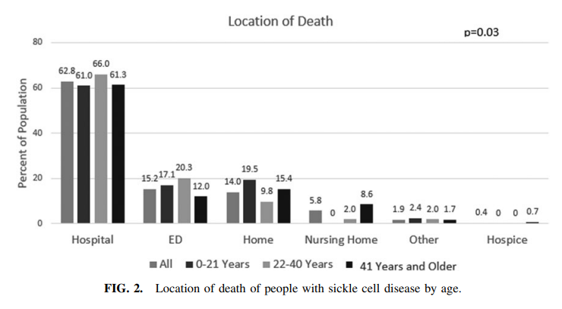
Acute Care Utilization at End of Life in Sickle Cell Disease: Highlighting the Need for a Palliative Approach
Examined 486 deaths (2006 – 2015)
Median age of death 45 years
63% died in the hospital, 15% in the emergency department
Pts hospitalized for 42 days in last year of life (over 5 admissions)
Month before death → acute care utilization sharply increased
Highlights need for advance care planning
Johnston EE, Adesina OO, Alvarez E, Amato H, Paulukonis S, Nichols A, Chamberlain LJ, Bhatia S. Acute Care Utilization at End of Life in Sickle Cell Disease: Highlighting the Need for a Palliative Approach. J Palliat Med. 2020 Jan;23(1):24-32. doi: 10.1089/jpm.2018.0649. Epub 2019 Aug 7. PMID: 31390292.
Notes:
Most that died in the hospital died after short admissions (<3 days)
Our findings are consistent with previous studies of causes of death in people with SCD, which show that most die of acute complications and can be relatively healthy before that fatal episode
In conclusion, people with SCD are dying suddenly and at a young age. Comprehensive hematologic care of people with SCD needs to include high-quality acute care and advance care planning. The latter will be challenging as many of these conversations need to occur at community hospitals where adults with SCD are primarily receiving acute care and during the transition from pediatric-to-adult care, which is an already overwhelming time for young people with SCD. Therefore, many patients may require specialized palliative care integration into their SCD team so that their advance care planning needs and goal-directed care can be fully addressed.

Slide 21
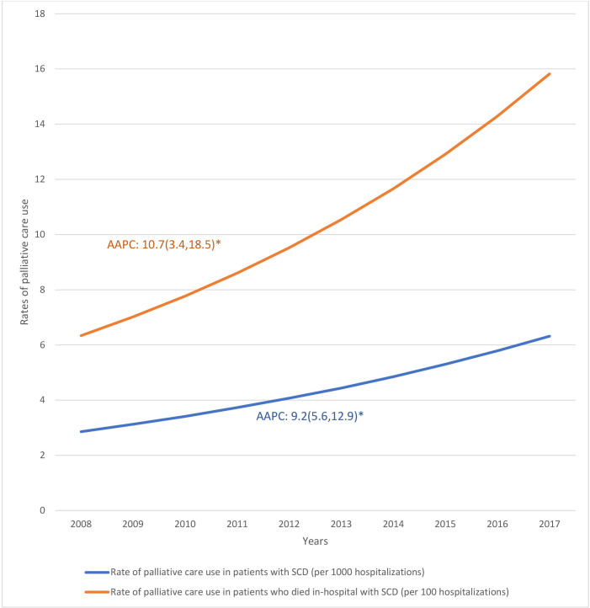
Inpatient palliative care use by patients with sickle cell disease: a retrospective cross-sectional study
Utilized national data to assess use of PC during SCD-related hospitalizations (2008-2017)
Only 0.45% of hospitalizations received PC service
Rate of utilization increased over study period, higher in terminal hospitalizations
Use of inpatient PC higher in older, NH white, male, higher income, sicker patients at more urban hospitals
Nwogu-Onyemkpa E, Dongarwar D, Salihu HM, Akpati L, Marroquin M, Abadom M, Naik AD. Inpatient palliative care use by patients with sickle cell disease: a retrospective cross-sectional study. BMJ Open. 2022 Aug 16;12(8):e057361. doi: 10.1136/bmjopen-2021-057361. PMID: 35973707; PMCID: PMC9386219.
Notes:
used national data to evaluate inpatient palliative care use during SCD-related hospitalisations overall and during terminal hospitalisations (hospitalisations that resulted in patients’ death in-hospital regardless of cause of death). We identified patient and hospital characteristics associated with use of hospital-based palliative care services in SCD.

Slide 22
Advance Care Planning in SCD
There is a paucity of data around ACP in patients with sickle cell disease
Research has shown us that ACP is limited by:
Mistrust
Desire to not have conversations documented
Reluctance to discuss dying
Limited data suggests ACP is not happening:
In a study of 70 patients (mean age 38 years):
87% reported not having written decisions for end-of-life medical treatment
All patients who did have documents were > 50 years old
90% wanted to talk about advance care planning
Frederick Bartholomew, Laura M. De Castro; Advance Care Planning In Adults with Sickle Cell Disease (SCD). Blood 2010; 116 (21): 391.

Slide 23
Advance Care Planning in SCD
“Death is as Much Part of Life as Living”: Attitudes and Experiences Preparing for Death from Older Adults with Sickle Cell Disease
Four major themes identified:
1. Anticipation of early death with sub-themes: (a) informed of early death and (b) making plans for death
2. Near death experiences
3. Differences in level of comfort with death with subthemes: (a) death as a part of life and (b) differences in level of comfort discussing death
4. Influence of spirituality with subthemes: (a) God controls the timing of death and (b) belief in the afterlife
Oyedeji, C. I., Strouse, J. J., Masese, R., Gray, N., & Oyesanya, T. O. (2022). “Death is as Much Part of Life as Living”: Attitudes and Experiences Preparing for Death from Older Adults with Sickle Cell Disease. OMEGA - Journal of Death and Dying, 0(0). https://doi.org/10.1177/00302228221116513

Slide 24
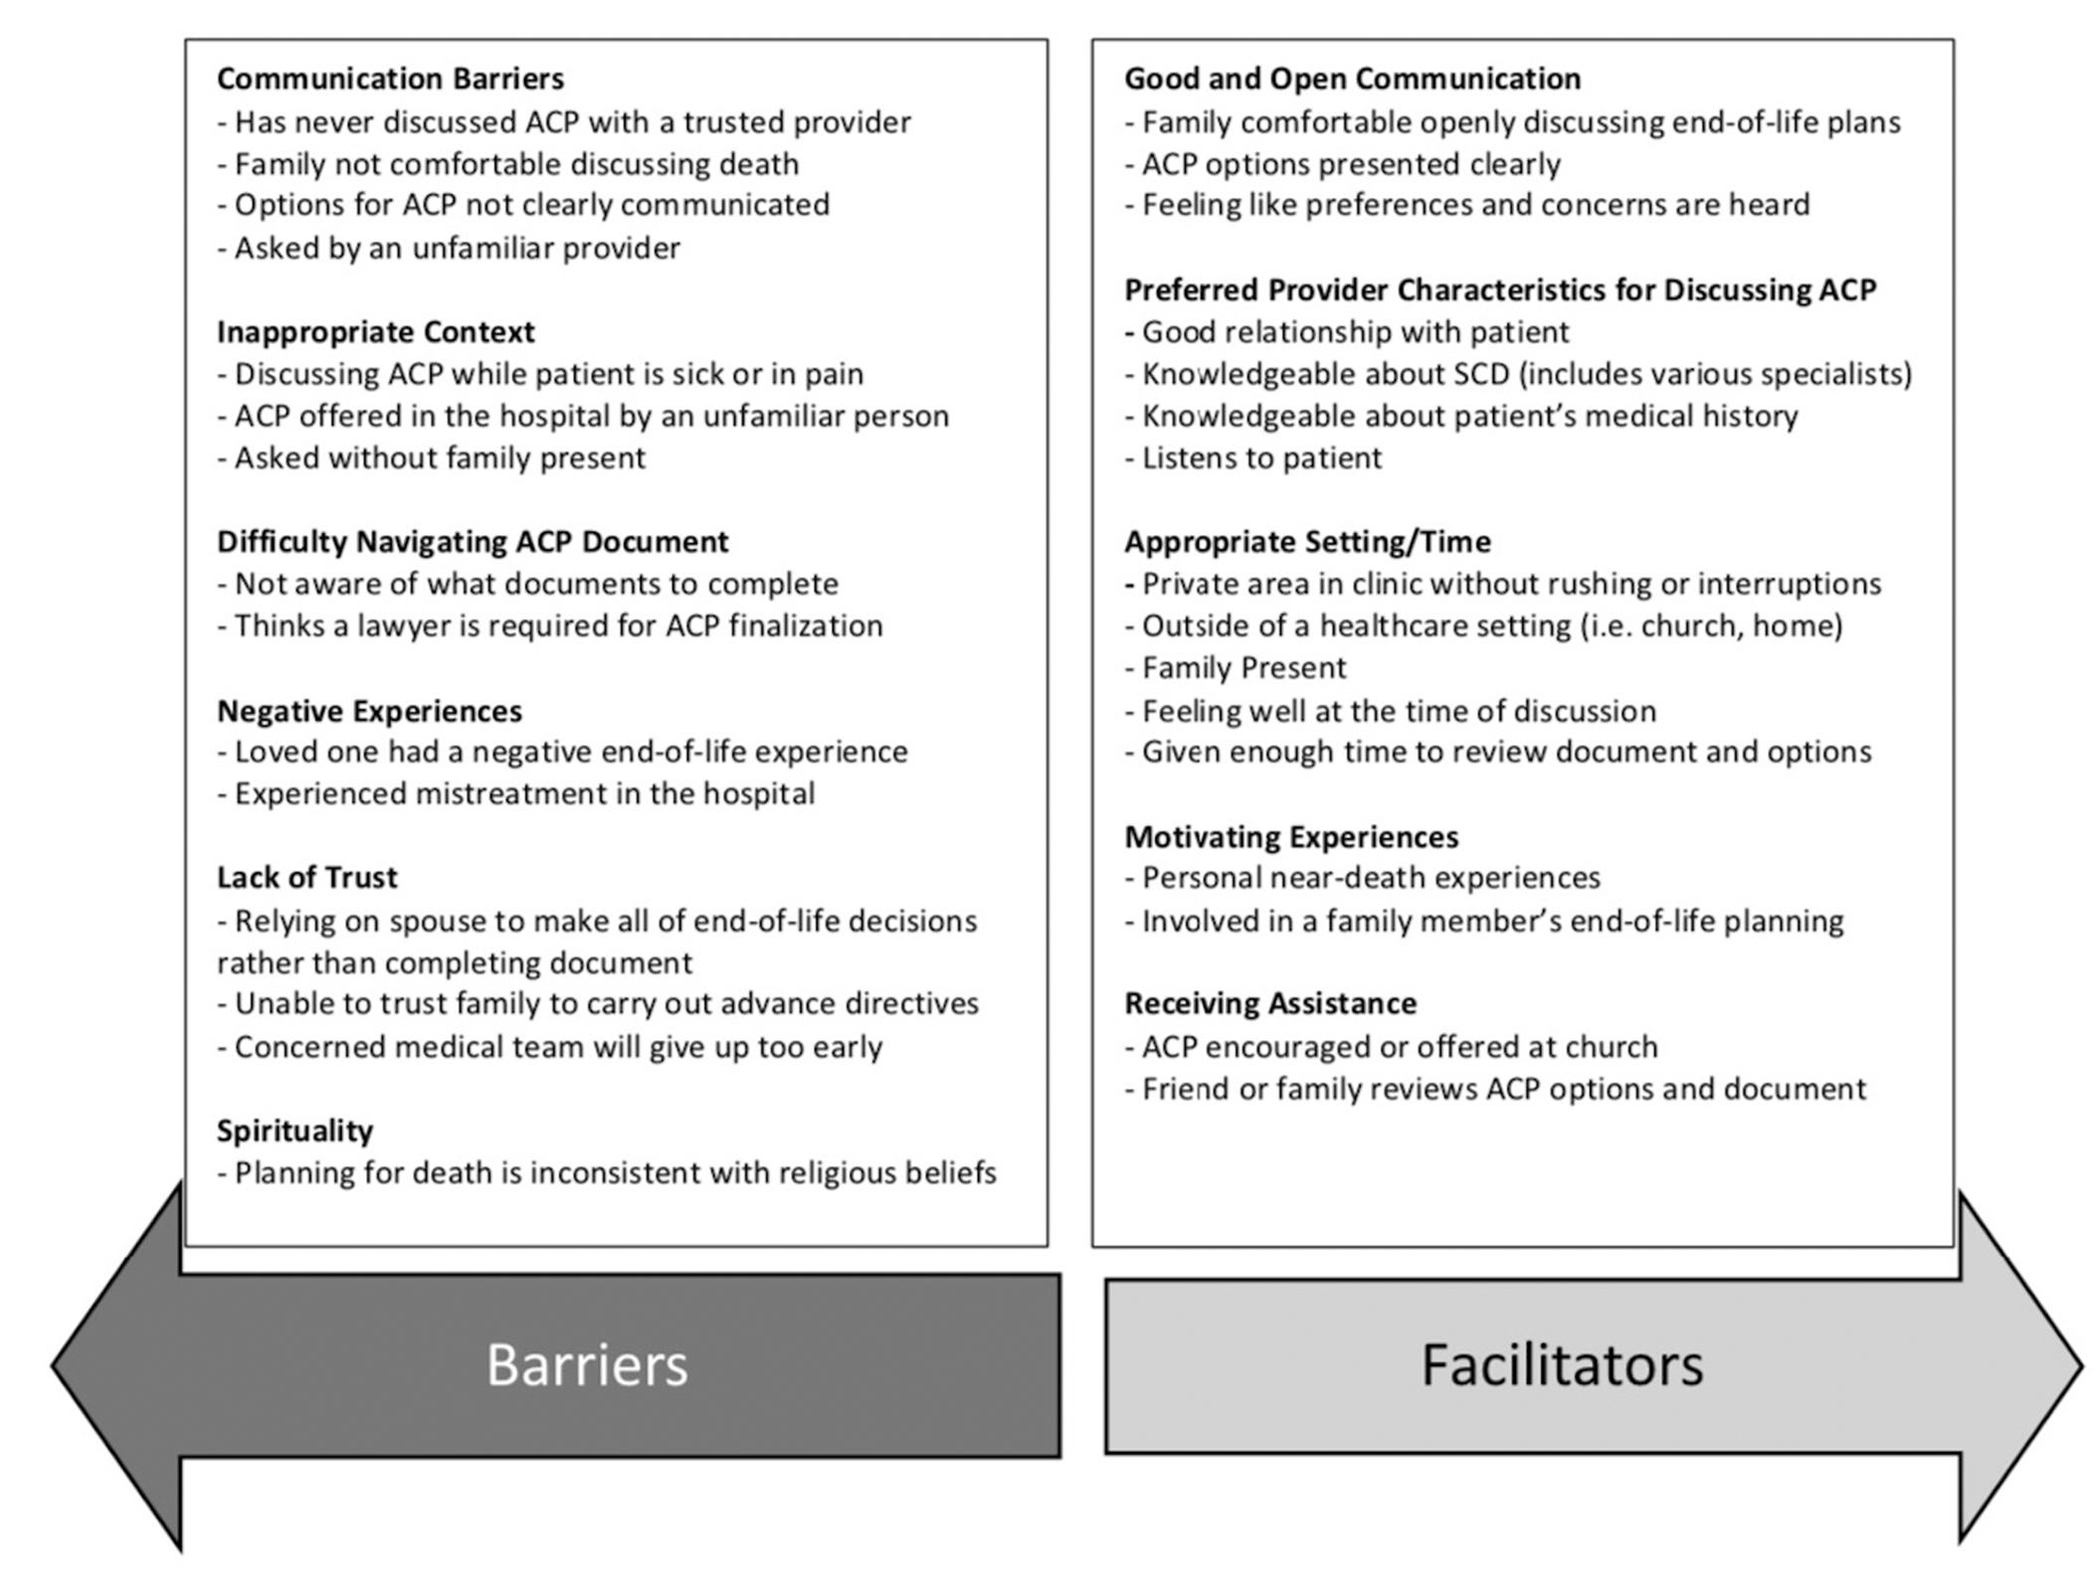
Advance Care Planning in SCD
Barriers and Facilitators of Advance Care Planning for Older Adults with Sickle Cell Disease
Charity I Oyedeji, Tolulpe Oyesanya, Nathan Gray, John J. Strouse,
Barriers and Facilitators of Advance Care Planning for Older Adults with Sickle Cell Disease,
Blood, Volume 136, Supplement 1,2020, Pages 58-59,
ISSN 0006-4971, https://doi.org/10.1182/blood-2020-136231.
Notes:
The mean age of participants was 57 years (range 50-71) and 47% (n = 9) were female. Most participants were diagnosed with SCD several years after birth and were told that they were not expected to live past age 18. Four of 19 participants had written advanced directives. Most participants were comfortable and willing to discuss ACP and thought that SCD ACP discussions should ideally start in early adulthood.
Older adults with SCD expressed a desire for communication about ACP from trusted providers who are knowledgeable about SCD and want to have ACP conversations when they are feeling well. In addition, having the patient's family present and giving them assistance may increase the patient's comfort in completing their advance directives. The lack of communication from trusted providers or communication from unfamiliar providers about ACP during hospitalizations for acute complications are major barriers to creating advance directives for older adults with SCD.

Slide 25
Outline
Quality of Life/Psychosocial Aspects of SCD
Literature in SCD + Palliative Care
Role(s) For Palliative Care
Next Steps
Notes:
Presentation has been modified from one I gave at our PC Grand Rounds in 2020- have given this talk several times to different groups (hematology, HPM fellows, PC colleagues) since that time. Appreciate your honest feedback. My overarching goal is to partner with

Slide 26
What is Palliative Care?
Palliative care is specialized medical care for people living with a serious illness. This type of care is focused on providing relief from the symptoms and stress of the illness. The goal is to improve quality of life for both the patient and the family.
Palliative care is provided by a specially-trained team of doctors, nurses and other specialists who work together with a patient’s other doctors to provide an extra layer of support. Palliative care is based on the needs of the patient, not on the patient’s prognosis. It is appropriate at any age and at any stage in a serious illness, and it can be provided along with curative treatment.
https://www.capc.org/about/palliative-care/

Slide 27
Diagnosis
Death
HEALTH
ILLNESS
DEATH
Curative & Life Prolonging Care
Palliative Care
Symptom
Management
Life
Closure
EOL/
Dying
Prevention
Bereavement
CURATIVE CARE
HOSPICE CARE
*Note: New Healthcare legislation affords children <18 access to standard therapies and concurrent hospice.

Slide 28
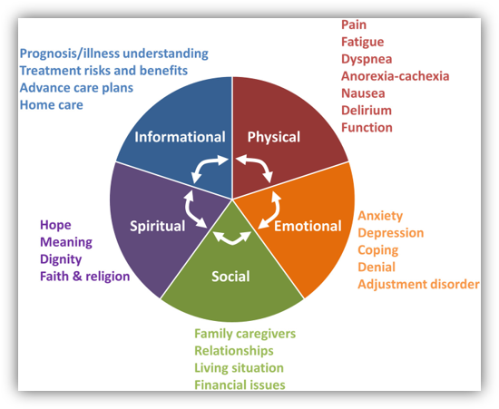
Domains of Palliative Care
Hui, D., Hannon, B.L., Zimmermann, C. and Bruera, E. (2018), Improving patient and caregiver outcomes in oncology: Team-based, timely, and targeted palliative care. CA: A Cancer Journal for Clinicians, 68: 356-376. https://doi.org/10.3322/caac.21490

Slide 29
Benefits of Early Integration of Palliative Care
RCT of pts w/metastatic NSCLC: pts who received PC intervention had better quality of life, lower rates of depression, and a 2.7-month survival benefit
Meta analysis: PC interventions were associated with improvements in patient QOL and symptom burden.
RCT of pts w/ advanced HF: interdisciplinary PC intervention showed consistently greater benefits in QOL, anxiety, depression, and spiritual well-being compared with UC alone
Improved caregiver/family outcomes
Cost savings
Shortened hospital stays
Improved EOL outcomes: pts more likely to die in their preferred setting, etc.
(Temel et al, NEJM 2010)
(Kavalieratos et al, JAMA 2016)
(Rogers et al, JACC 2017)
(Jay et al, JAMA 2018)

Slide 30
Now for a Transition Back to Sickle Cell Disease….

Slide 31
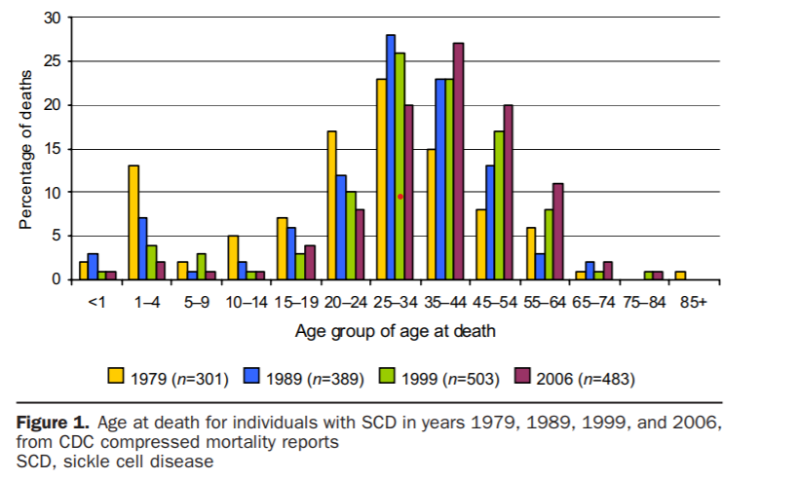
SCD- Prognosis
Life expectancy:
Current life average life expectancy: 42-48 years (compared to 78.5 years for the general population)
Much improved over last 50 years (was 20yrs in 1970!)
High childhood mortality in Sub-Saharan Africa (50-90% before age 5)
Main causes of death: CVA, acute chest, infection, multiorgan failure, sudden cardiac death
Severity of the disease based on many factors: HbF levels, Genotype & genetic variability, Social/economic/environmental
More than 3x VOC hospitalizations per year → early risk of death
Having frequent or prolonged episodes of pain is a key predictor of morbidity and mortality
Hassell / Am J Prev Med 2010;38(4S):S512–S521
Notes:
Most of these children in sub-Saharan Africa die from infections, including invasive pneumococcal disease and malaria. Immune function in pediatric SCD patients is impaired for a variety of reasons, including deficient splenic clearance of opsonized encapsulated bacteria (10, 11). This results in a propensity to infection by encapsulated bacteria such as Streptococcus pneumoniae, Haemophilus influenzae, Salmonella typhi and non-typhi, and Meningococcal species. In sub-Saharan Africa, one-half of patients with SCD die from infection before the age of 5, and children with SCD are >50 times more likely to suffer from invasive pneumococcal disease. 25 percent of children with SCD do not receive pneumococcal vaccination, which is recommended for all children younger than five years of age.
SCA, the most common form of SCD, is a lifelong disease characterized by chronic haemolytic anaemia, unpredictable episodes of pain and widespread organ damage. There is a wide variability in the clinical severity of SCA, as well as in the life expectancy²
→ Main causes of death in SCD CVA, acute chest, infections, multiorgan failure.
The variability in the clinical severity of SCA can partly be explained by genetic modifiers, including factors that affect HbF level and co-inheritance of α-thalassaemia (see below)^{31,32}.
Environmental factors (such as the home environment, socio-economic status, nutrition and access to care)
AS MORE OF THESE PATIENTS ARE SURVIVING INTO ADULTHOOD, THE MORE COMPLICATIONS THEY WILL SUFFER FROM. AS YOU CAN IMAGINE WITH ANY PATIENT WITH A LIFE-LIMITING ILLNESS, THERE ARE

Slide 32
With increasing life expectancy comes….
Increasing rate of morbidity due to complications
Observational study: 73% of SCD deaths with >1 form of irreversible organ damage
Higher symptom needs
Psychological/social stress of living with life-limiting illness
Issues re: planning for the future (ACP)
Medical care plans
Decision makers
Plans for end of life, wishes surrounding advanced interventions, etc.
Powars DR, Chan LS, Hiti A, Ramicone E, Johnson C. Outcome of sickle cell anemia: a 4-decade observational study of 1056 patients. Medicine (Baltimore). 2005 Nov;84(6):363-376. doi: 10.1097/01.md.0000189089.45003.52. PMID: 16267411

Slide 33
A Case for Palliative Care in SCD
Pain & symptom management (acute/chronic)
Advanced Care Planning
Transitions of care
Communication/care coordination between patients/providers
Improving QOL & functioning
Focus on “total pain”
Complex medical decision making
Social Justice/Advocacy
Integrated/Multidisciplinary Care Models
Notes:
The patient-focused and family-oriented interventions can be modeled to fit “any place, any time,” outpatient, inpatient or the home, with homecare and other support systems. Such are the needs in SCD: appropriate, timely and compassionate care to prevent or relieve suffering and to preserve dignity, meaning, value and quality of life with improvement that is translational from birth until the end of life.

Slide 34
The Power of the Multidisciplinary Approach
Five-year study at Yale New Haven Children’s Hospital demonstrated the power of incorporating multiple modalities into the treatment of pain:
Team including representatives from hematology, child psych, psychiatry, adolescent medicine, pain med, peds EM, nursing, social work, child life, and QI
61% reduction in hospitalizations, a decreased LOS and a reduction in readmission rates from 33.9% to 19.4%
Balsamo L, Shabanova V, Carbonella J, Szondy MV, Kalbfeld K, Thomas DA, Santucci K, Grossman M, Pashankar F. Improving Care for Sickle Cell Pain Crisis Using a Multidisciplinary Approach. Pediatrics. 2019 May;143(5):e20182218. doi: 10.1542/peds.2018-2218. Epub 2019 Apr 3. PMID: 30944154.
Notes:
Though PC not directly involved in this study, one could extrapolate that if they were, results would be similar given PC is inherently multidisciplinary and person-centered in its approach.

Slide 35
PC needs of patients with sickle cell disease
Patients with SCD may experience:
Social and emotional isolation – often the only one in family with disorder
Disruption in daily routine, education and career
Frustration with health care system
Patients with SCD may face treatment decisions:
Advanced therapies
BMT
Amplification in depressive mood
Expressed helplessness and hopelessness
Anxiety
Cognitive impairment
Difficulty with peer & family relationships
Laurence B, George D, Woods D. Association between elevated depressive symptoms and clinical disease severity in African-American adults with sickle cell disease. J Natl Med Assoc. 2006;98:365-369

Slide 36
PC needs of patients with SCD
Recurrent hospitalizations and ED visits due to complications of disease
Most patients with SCD die in the hospital (63%) or ED (15%)
In their last year of life people with SCD were hospitalized for an average of 42 days (SD: 49 days) over five admissions
Inpatient admissions and ED visits increases sharply a month before death
Paulukonis ST, Feuhtbaum LB, Coates TD, et al. Emergency department utilization by Californians with sickle cell disease, 2005-2014. Pediatr Blood. June 2017;64(6):e26390.
Blinder MA, Duh MS, Sasane M, et al. Age-Related Emergency Department Reliance in Patients with Sickle Cell Disease. J Emerg Med. 2015 Oct; 49(4): 513-522.
Johnston EE, Adesina OO, Elysia Alvarez E, et al. Acute care utilization at end of life in sickle cell disease: Highlighting the need for a palliative approach. Journal of Palliative Medicine. Jan 2020.24-32.

Slide 37
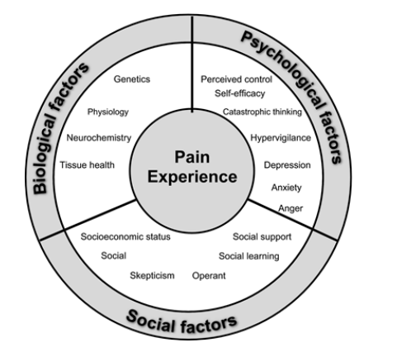
PC interventions in SCD
Pain management in patients with complex multimodal pain regimens
Assessment of “Total Pain”
Palliative care can make recommendations for non-pharmacological pain management interventions

Slide 38
PC Interventions in SCD
Advanced care planning
Goals of care discussions
Navigation of medical treatment and coordination of care
Plan for pain crisis and coordination with ED teams
Collaboration with hematologists to discuss disease trajectory
Treatment decision making
Psychosocial and spiritual support
Need for mental health support
Need for social work involvement

Slide 39
In Summary…
Patients with severe forms of sickle cell disease with end organ involvement are ideal candidates for palliative care due to high symptom burden, need for psychosocial support and advanced care planning.

Slide 40
Outline
Quality of Life/Psychosocial Aspects of SCD
Literature in SCD + Palliative Care
Role(s) For Palliative Care
Next Steps

Slide 41
Next Steps
Development of Palliative Care in Sickle Cell Disease Working Group
In progress “Top Ten Tips” paper
Increasing exposure of palliative care through educational presentations
Development of “How-To” Guides for PC providers embedded within Comprehensive SCD clinics
Survey of PC providers assessing their perspectives/perceptions of role in SCD
Conduct delphi study to define role of palliative care in SCD
Presentation at NHLBI Sickle Cell Conference

Slide 42
Discussion topics:
Any experience with palliative care and SCD patients?
What types of conversations re: ACP are currently happening with patients in the outpatient/inpatient setting?
What types of patients might be appropriate for referral? What symptoms/issues are you having the most difficulty managing?
How might you envision collaboration?
New areas to study? How to measure impact of PC with SCD patients?
How to garner further support within the fields of hematology/PC?

Slide 43
Thank you for your attention! QUESTIONS?
Contact: Ashley.Allen@duke.edu

Slide 44
Sources
Format:
Pain-measurement tools in sickle cell disease: where are we now?
Puri L, Morgan KJ, Anghelescu DL. Ketamine and lidocaine infusions decrease opioid consumption during vaso-occlusive crisis in adolescents with sickle cell disease. Curr Opin Support Palliat Care. 2019 Dec;13(4):402-407.
Haywood, C. et al. The impact of race and disease on sickle cell patient wait times in the emergency department. Am. J. Emerg. Med. 31, 651–656 (2013).
McClish DK, Smith WR, Dahman BA, Levenson JL, Roberts JD, Penberthy LT, Aisiku IP, Roseff SD, Bovbjerg VE. Pain site frequency and location in sickle cell disease: the PiSCES project. Pain. 2009 Sep;145(1-2):246-51.
Waldrop RD, Mandry C. Health professional perceptions of opioid dependence among patients with pain. Am J Emerg Med 1995;13:529–531
Midence K, Elander J, Sickle Cell Disease: A Psychosocial Approach. Radcliffe Medical Press, Oxford, England1994
Ashley N. Junghans-Rutelonis, Kristin L. Moquist, Rae M. Blaylark, Nicole Anderson, Melanie L. Brown,
Incorporating integrative medicine and patient preferences into a pilot interdisciplinary sickle cell wellness clinic, Complementary Therapies in Medicine, Volume 49, 2020,
McClain B, Kain ZN. Pediatric palliative care: a novel approach to children with sickle cell disease. Pediatrics. 2007;119:612–614.
When Actions Speak Louder Than Words — Racism and Sickle Cell Disease. Alexandra Power-Hays, M.D., and Patrick T. McGann, M.D. NEJM. September 1, 2020
Wilkie DJ, Johnson B, Mack AK, Labotka R, Molokie RE. Sickle cell disease: an opportunity for palliative care across the life span. Nurs Clin North Am. 2010;45(3):375-397. doi:10.1016/j.cnur.2010.03.003
Pain Management in Sickle Cell Disease: Palliative Care Begins at Birth? Lennette Benjamin. A
Kato, G., Piel, F., Reid, C. et al. Sickle cell disease. Nat Rev Dis Primers 4, 18010 (2018). https://doi.org/10.1038/nrdp.2018.10
Platt, O. S. et al. Mortality in sickle cell disease. Life expectancy and risk factors for early death. N. Engl. J. Med. 330, 1639–1644 (1994).
Piel, F. B., Steinberg, M. H. & Rees, D. C. Sickle cell disease. N. Engl. J. Med. 376, 1561–1573 (2017).
Ware, R. E., de Montalembert, M., Tshilolo, L. & Abboud, M. R. Sickle cell disease. Lancet 390, 311–323 (2017).
Ballas SK, Lusardi M. Hospital readmission for adult acute sickle cell painful episodes: frequency, etiology, and prognostic significance. Am J Hematol. 2005;79(1):17-25.
Patient-controlled analgesia versus continuous infusion of morphine during vaso-occlusive crisis in sickle cell disease, a randomized controlled trial
A Phase 3 Trial of l-Glutamine in Sickle Cell Disease, NEJM
Crizanlizumab for the Prevention of Pain Crises in Sickle Cell Disease, NEJM
Evidenced based management of Sickle Cell Disease
Low-Dose Ketamine Infusion In Adult Patients With Sickle Cell Disease – Impact On Management Of Acute Painful Episodes
Dunlop RJ, Bennett KC. Pain management in sickle cell disease. Cochrane Database Syst Rev. 2006; 2 (CD003350.)
Palm N, Floroff C, Hassig TB, Boylan A, Kanter J. Low-Dose Ketamine Infusion for Adjunct Management during Vaso-occlusive Episodes in Adults with Sickle Cell Disease: A Case Series. J Pain Palliat Care Pharmacother. 2018 Mar;32(1):20-26. doi: 10.1080/15360288.2018.1468383. Epub 2018 May 23. PMID: 29791238.

