Slide 1
APPHON febrile neutropenia updates AND Asparaginase formulations, allergic reactions, antibody production, asparaginase levels, rechallenge and desensitization
Tamara MacDonald PharmD
Clinical Pharmacy Specialist Hematology/Oncology
IWK Health Center/Dalhousie University, Halifax NS
Tamara.macdonald@iwk.nshealth.ca

Slide 2
Conflict of interest disclosure
None

Slide 3
Objectives
Review the updates to the APPHON febrile neutropenia guideline.
Review the mechanism of action of asparaginase in children and young adults with ALL.
Describe differences in the pharmacokinetic and pharmacodynamic parameters between available asparaginase formulations.
Discuss methods of measuring asparaginase activity in clinical practice.
Discuss hypersensitivity reactions, re-challenge, desensitization and silent inactivation.

Slide 4
APPHON febrile neutropenia guideline – Updated reference.
The explanation for the supporting evidence for this guideline is in the reference section. This guideline was originally based on the C17 endorsed guideline for the management of fever and neutropenia in children with cancer and/or undergoing hematopoietic stem cell transplantation 2012 and the 2017 update and more recent evidence based upon guidance from the recent publication Lehrnbecher T, Robinson PD, Amman RA, et al. Guideline for the Management of Fever and Neutropenia in Pediatric Patients With Cancer and Hematopoietic Cell Transplantation Recipients: 2023 Update. JCO 2023;41((0:1774-1785) and has been revised for use in the Maritime Provinces.

Slide 5
APPHON febrile neutropenia guideline – Updated information on thermometer use
Fever is defined as a single oral or tympanic temperature greater than or equal to 38.3°C or oral or tympanic temperature greater than or equal to 38°C for 1 hour or more. Oral temperatures (and/or thermometers that read core body temperature, e.g., tympanic thermometers) are more reliable and are thus preferred. However, when axillary temperatures are the only option (e.g., very young children or when a tympanic thermometer does not yield an accurate temperature), fever is defined as a single axillary temperature of greater than or equal to 37.8°C or axillary temperature greater than or equal to 37.5°C for 1 hour or more. NOTE: A non-contact infrared thermometer or fever strips are not recommended.

Slide 6
APPHON febrile neutropenia guideline – Updated information on lactate levels
Obtain CBC and differential, Lactate and aerobic and anaerobic blood cultures from all lumens of CVAD within 30 minutes of arrival. If patient does not have a CVAD draw a peripheral culture. (NOTE: Pediatric culture bottles automatically include testing for both aerobic and anaerobic. Also aerobic blood cultures automatically include fungal cultures as all fungi are aerobic.)
NOTE: Repeat lactate levels should be considered in patients who have high levels on presentation and/or those that are unwell. Routine repeat measurement of lactate levels outside a clinical concern for sepsis is not required.

Slide 7
APPHON febrile neutropenia guideline – Updated information on antifungal therapy
Patient parameters | Plan for pediatric hematologist/oncologist
High risk patients for IFD: AML Prolonged neutropenia and: HR/VHR ALL (includes T-cell and infant ALL) Relapsed ALL High dose steroids HSCT (1st year post without evidence of T-cell reconstitution, or receiving steroids or multiple immune suppressive agents for GVHD) | Start caspofungin pre-emptively in post HSCT patients. Consider deferring empiric antifungal therapy and consulting ID and conducting full fungal workup with CT chest and abdomen +/- CNS) AND initiating caspofungin only if evaluation suggests or indicates IFD. IF patient is already on caspofungin for fungal prevention consult ID.
Low risk patients for IFD (All patients who are not high risk) with fever greater than or equal to 38.3 ◦ C for 96 hours. | Consider withholding empiric antifungal therapy and consult ID + a full fungal workup (CT chest +/- abdomen +/- CNS)
Recommendations on when to consider starting empiric antifungal therapy on patients with neutropenia and persistent fever (5-days or longer) and/or who are clinically deteriorating.

Slide 8
Asparaginase

Slide 9
Where does asparaginase come from?
Animals
Plants
Fungus
Actinomycetes
Algae
Bacteria – proven most beneficial in drug manufacturing; E.coli and Erwinia chrysanthemi
Protein engineering or modified versions of the enzyme reduce hypersensitivity of native preparations for example PEGylated and recombinant products.

Slide 10
History of asparaginase in the treatment of ALL
1953
Scientist noticed that B-lymphoma cells in mice died when given guinea pig serum. They determined it was the asparaginase enzyme that caused the cell death.
1978
FDA approve native e.coli l-asparaginase (kidrolase®)
1985
Erwinia chrysanthemi (Erwinaze®)was approved in the UK.
1994
Pegaspargase (pegylated e.coli) was approved as second line by the FDA.
2006
Pegaspargase was approved as first line by FDA
2011
Erwiniase® was approved by the FDA
2018
Calaspargase Pegol (pegylated e.coli) was approved by the FDA. Will be approved by HC in 2024/25.
2021
Rylaze (erwinia chrysanthemi recombinant-rywn was approved by the FDA and in 2023 by HC.

Slide 11
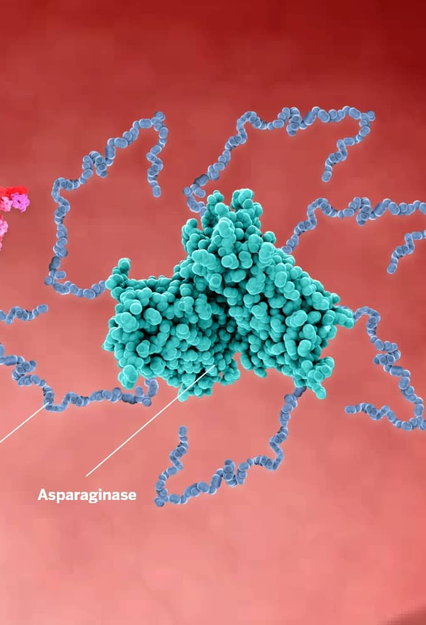
Asparaginase products available in North America
PEGylated E.coli which includes pegaspargase and calaspargase pegol.
1. Pegaspargase (Oncaspar®) linker is succinimidyl succinate
2. Calaspargase pegol (Asparlas®) linker is succinimidyl carbonate that results in a more hydrolytically stable formulation with a longer half-life.
Erwiniaze® or Erwinase® is derived from the bacteria erwinia chrysanthemi.
Rylaze® asparaginase erwinia chrysanthemi (recombinant) – is derived from different bacteria that have been genetically altered with erwinia chrysanthemi which decreased production time to 3 weeks and removes the issue of shortages.

Slide 12
How does asparaginase work?
Asparaginase hydrolyzes the amino acid L-asparagine to L-aspartic acid and ammonia.
Asparagine is required for DNA synthesis and cell survival.
Acute lymphoblastic leukemia (ALL) cells grow quickly and have rapid metabolic processes.
ALL cells lack adequate levels of the required enzyme, asparagine synthetase, and require higher amounts so cannot survive asparagine depletion.

Slide 13
Mechanism of action of asparaginase
Leukemia cell does not produce L-asparagine due to low levels of asparagine synthetase
Blood
L-asparagine
L-asparaginase
L-aspartate
+
Ammonia
Extracellular
Intracellular

Slide 14
Properties required of asparaginase products
High binding affinity for its substrate asparagine (low Km value).
Stable and active in pH of blood around 7.
Low glutaminase activity – glutaminase causes non-immunologic side effects due to disruption of protein synthesis.
No adverse effects.
No immunogenic complications.
Delayed clearance from plasma (long half-life).

Slide 15
Asparagine depletion
Asparaginase products deplete asparagine and glutamine, nonessential amino acids required for cell growth.
Leukemia cells lack the ability to synthesize asparagine so rely on plasma asparagine to survive.
Asparaginase products deplete plasma asparagine = leukemia cell death.
Asparaginase products deplete plasma glutamine = non immunologic adverse effects (as glutamine required to reduce oxidative stress on cells).
Glutamine can be used as an amino-group donor for asparagine, but it has been shown that leukemic cell death occurs without glutamine depletion.

Slide 16
Ways to measure asparaginase activity
Serum asparagine levels:
Normal levels range from 40-80 uM and 0.1-0.2 uM considered complete depletion based on sensitivity of testing and NOT on formal criteria.
Critical level of asparagine depletion for leukemic cell death is not known .
Measured by high performance liquid chromatography.
Asparagine difficult to measure as degraded readily ex vivo.
Anti-asparaginase antibody production:
Enzyme-linked immunosorbent assay IgG levels shows active antibodies but difficult to quantify so unreliable and not a validated surrogate of leukemia outcomes.
Asparaginase activity levels:
A surrogate marker of leukemic cell death as inversely correlate with serum asparagine concentration
Validated level of activity and current reliable method of measuring asparaginase efficacy.

Slide 17
Minimum asparaginase activity levels required for asparagine depletion
In 1981, Riccardi et al. administered E.coli and Erwinia asparaginase to rhesus monkeys and patients and found that plasma asparaginase activity levels above 0.1 IU/mL resulted in complete asparagine depletion in CSF and plasma.
Riccardi, R., 1981;41:4554-8

Slide 18
Therapeutic levels of asparaginase
The cut-off of > 0.1 IU/mL has been confirmed and used in many clinical leukemia trials.
Several trials have looked at a lower cut-off of 0.02-0.05 IU/mL but complete depletion is not consistent below 0.1 IU/mL.
van der Sluis, IM., et al. 2016;100:279-285

Slide 19
Asparaginase Formulations
long-acting short-acting
Pegaspargase
Calaspargase pegol-mknl
Asparaginase Erwinia chrysanthemi
Crisantaspase [L- asparaginase from Erwinia chrysanthemi]
Asparaginase Erwinia [Recombinant]
‘peg-asparaginase’ ‘PEG’
‘SS-PEG’
Oncaspar™
‘CAL-PEG’
‘SC-PEG’
Asparlas™
‘erwinia’ Erwinaze™
‘erwinia’ ‘crisantaspase’ Erwinase™
‘RC-P’
‘JZP458’
Rylaze™
same drug

Slide 20
Asparaginase Formulations PK data
Drug | Initial FDA approval | Half-life (days) | Recommended dosing and interval | Recommended interval
Pegaspargase (Oncaspar®) | 1994 | IM: 5.73 | 2,500 IU/m² for patients | No more frequently than every 14 days
 |  | IV: 5.3 | ≤21 years
 |  |  | 2,000 IU/m² for patients
 |  |  | >21yrs
Calaspargase pegol- | 2018 | IV: 13.4 | 2,500 IU/m² (only | No more frequently
Mkln (Asparlas®) |  | IM: NA | approved or patients 1 month to ≤ 21 | than every 21 days
 |  |  | years)
Asparaginase Erwinia | 2011 | IM: 0.65 | 25,000 IU/m² | 3 times/week
Chrysanthemi (Erwinaze®) |  | IV: 0.31 |  | (M/W/F) for 6 doses
Asparaginase erwinia chrysanthemi (recombinant)-rywn (Rylaze®) | 2021 | IM: 0.76 | 25 mg/m² | Every 48 hours OR on Monday and Wednesday AND
 |  | IV: TBD | 50 mg/m² | on Friday
IM, intramuscular; IV, intravenous; IU, International Units; M/W/F, Monday, Wednesday, Friday.
Half-life of the agent may be shorter if previously exposed to a product isolated from the same organism or if a hypersensitivity reaction has occurred

Slide 21
Long Acting Asparaginase Products

Slide 22
Calaspargase Pegol Use in COG Trials
Servier plans to eventually discontinue pegaspargase (likely in 2025/26)
Calaspargase pegol lacks safety and efficacy data in adults > 22 years and infants < 1 year of age
Adult trials recently started enrolling patients
Calaspargase pegol currently not available outside of US
Servier limited the use of pegaspargase in the US to patients < 1 month and > 21.5 years on 12/1/22
COG ALL Trials
In the process of being amended to allow calaspargase pegol use in all phases of therapy
Dose-capping for baseline obesity for long-acting asparaginase products is permitted
Delayed Intensification (DI) cycles extended to 9 weeks (63 days) in high-risk arms to allow for 21 days between calaspargase pegol doses

Slide 23
COG Pegylated Asparaginase Dosing
PEGASPARGASE
Patients < 22 years:
2,500 International Units/m2/dose IV or IM* at least 14 days apart
Patients ≥ 22 years:
2,000 International Units/m2/dose IV or IM* at least 14 days apart
CALASPARGASE PEGOL
Patients < 22 years:
2,500 International Units/m2/dose IV* at least 21 days apart
Patients ≥ 22 years:
Not indicated; Use pegaspargase
Dose capping at 3,750 units/dose (1 vial) per institutional policy is permissible in cases of baseline obesity.
*Note: Obesity has been linked to increased risk of toxicity in patients ≥ 10 years of age. Obesity is defined as ≥ 95% BMI for age for patients < 20 y.o or BMI ≥ 30 for patients ≥ 20 y.o

Slide 24
Calaspargase Pegol Dosing in COG Trials
AALL1731, AALL1732, AALL1631 and AALL1621 replace
pegaspargase with calaspargase pegol on 1:1 basis in all phases of therapy
AALL1821 is in the process of being amended
Pegaspargase will continue to be given on Days 2 & 16 of VXLD regimen
Calaspargase pegol will be given on Day 2 ONLY (1 dose) of VXLD regimen

Slide 25
Short acting asparaginase products

Slide 26
Asparaginase Erwinia Chrysanthemi (Recombinant)–rywn
New FDA approved dosing recommendations are based on the “intended duration of asparagine depletion”
Result of modeling simulations to maintain nadir serum asparaginase activity (NSAA) levels > 0.1 U/mL for ~ 90% of patients
AML and Down syndrome data is not available
Premedication use is a “recommendation” not a mandate implemented by the FDA for consistency with other asparaginase products
COG protocols leave premedication decision to be investigator’s choice
COG recommends monitoring asparaginase activity levels for silent inactivation when routine premedications are used

Slide 27
Asparaginase Erwinia Chrysanthemi (Recombinant)-rywn

Slide 28
Reactions

Slide 29
Calaspargase pegol compound
https://asparlas.com/SRV_About_Asparlas_Asparagine

Slide 30
Antibody mediated reactions
Usually present during second dose or subsequent doses
Result from antibody-mediated immune response
The reported rates of hypersensitivity reactions are variable depending on the reaction severity and type
Any grade: 0-37%
Grade ≥3: 0-9%
Clinical inactivation: 0-8% (patients do not maintain therapeutic serum asparaginase levels after a documented clinical reaction)
Silent inactivation or subclinical inactivation: 0-3% (patients do not maintain therapeutic serum asparaginase levels and do not experience a clinical reaction (no symptoms).
May result in reduced asparaginase activity levels in up to 8% of patients which means the likely cause of these reactions is antibody production to other components of the product in this case the polyethylene glycol.

Slide 31
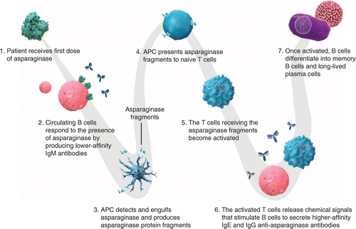
Mechanism of asparaginase antibody mediated reaction
https://www.futuremedicine.com/doi/10.2217/fon-2021-1288

Slide 32
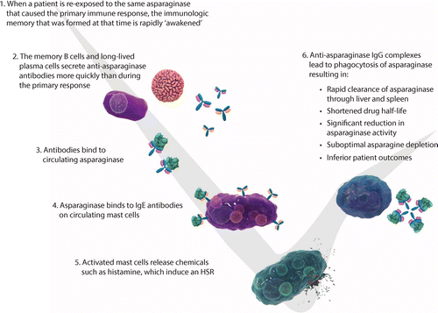
Mechanism of asparaginase antibody mediated reaction cont’d
https://www.futuremedicine.com/doi/10.2217/fon-2021-1288

Slide 33
Non-antibody mediated reactions
Usually present on first dose, and risk may diminish with exposure
Can have several mechanisms on innate immune system, including
Direct cytokine release
Activation of complement system
Spike in plasma ammonia
Not suggestive of a lack of therapeutic asparaginase activity levels and most patients can be rechallenged or desensitized.
The symptoms of an antibody mediated reaction are very similar to a non-antibody mediated reaction so clinically it is impossible to differentiate and why serum asparaginase levels are required.

Slide 34
Asparaginase serum/plasma levels and deactivation experience from the IWK
We monitor serum/plasma asparaginase levels on all patients with every dose due to the possibility of deactivation of the asparaginase occurring with any dose.
We implemented universal premedication in 2021 based on an evidence informed decision to reduce reaction intensity and lower antibody production.
An average of 3 patients per year reacted prior to implementation of premedication and 1 per year post implementation.
Administration of corticosteroids has not made a difference in our population so immune modulation does not appear to occur to reduce antibody production.
We monitor a serum/plasma level for pegaspargase at day 7 to ensure adequate asparaginase levels and give time to switch if needed.
Hypersensitivity reactions occur in 15-30% of our patients but most of these are infusion reactions to the polyethylene glycol and not the asparaginase.
Silent inactivation is the production of antibodies that deactivate the asparaginase in the blood without clinical signs of a reaction = 0% at the IWK (2016-2023). This means that the likelihood of deactivation of asparaginase without a clinical reaction even with premedication is minimal.
Once neutralizing antibodies are produced the drug has to be switched to a short acting asparaginase product such as Erwiniase or Rylaze. We will move to use Rylaze as approved by HC and publicly funded (on and off study patients).
Clinical inactivation is the production of antibodies that deactivate the asparaginase in the blood without clinical signs of a reaction = 6 patients/96 with clinical inactivation = 7% (2016-2023), 5 HR and 1 LR at the IWK.

Slide 35
Pegaspargase administration and hypersensitivity guide

Slide 36
Hypersensitivity reaction grading as per the IWK
Mild Reaction
Sign(s)/Symptom(s) from 1 organ system present.
Cutaneous: Urticaria and/or erythema-warmth and/or pruritus, other than localized at the injection site; And/or Tingling, or itching of the lips Or
Upper Respiratory: Nasal respiratory (e.g., sneezing, rhinorrhea, nasal pruritis, and/or nasal congestion); And/or Throat-clearing (itchy throat); And/or Cough not related to bronchospasm Or Conjunctival: Erythema, pruritus, or tearing Or Nausea/Metallic taste.
Moderate Reaction
Sign(s)/Symptom(s) from 2 or greater organ systems listed in mild reaction.
Lower airway: mild bronchospasm, e.g., Cough, wheezing, shortness of breath which responds to treatment; And/or Gastrointestinal: Abdominal cramps and/or vomiting/diarrhea; Other: uterine cramps, any symptom(s)/sign(s) from mild reaction would be included.
Severe Reaction
Lower airway: severe bronchospasm, e.g., not responding or worsening in spite of treatment; And/or Upper airway: laryngeal edema with stridor, any symptom(s)/sign(s) from mild reaction or moderate reaction would be included, Lower or Upper airway: respiratory failure, And/or Cardiovascular: collapse/hypotension*, And/or loss of consciousness (vasovagal excluded), any symptom(s)/sign(s) from mild, moderate or severe reactions would be included.
*Hypotension is defined by: Infants/children: low systolic blood pressure (age-specific) or greater than 30% decrease in systolic blood pressure.
Cox LS, Sanchez-Borges M, Lockey RF. World allergy organization systemic allergic reaction grading system: is a modifi-cation needed? J Allergy Clin Immunol Pract. 2017;5(1):58–62

Slide 37
Asparaginase rechallenge
For patients who have a mild reaction they can be rechallenged.
Stop the infusion and treat the reaction.
Once symptoms subside can restart the infusion.
If symptoms manifest stop the infusion.
Draw an asparaginase level.
For a patient who has had a clinical reaction asparaginase levels at day 14 are required.

Slide 38
Asparaginase desensitization
Appropriate for all patients who do not receive at least 50% of their dose prior to the reaction and those that receive greater than 50% and maintain asparaginase serum levels.
Appropriate for all degrees of reaction except cardiovascular collapse and severe bronchospasm.
Required with every dose.
Currently practice is to admit to oncology for infusion and monitoring.
Intensive premedication regimen starting the day before the desensitization.
Slow infusion with increasing concentrations of pegaspargase over 6-8 hours.
Strict monitoring of asparagianse levels at 1 hr, day 2, 7 and 14.
If therapeutic levels not maintained patient is switched to short acting asparagainse (erwiniase/rylaze).
We have desensitized 7 patients since 2020. All patients tolerated the desensitization but 2 patients did not maintain therapeutic levels.
All patients that were desensitized had a moderate to severe reaction (Grade 3 or higher).
Desensitization allows for administration of 1st line asparagianse product, is cost effective and improves QOL of patients by avoiding multiple IM injections with erwiniase/rylaze.

Slide 39
Summary
APPHON febrile neutropenia guideline updates:
Forehead temperature monitoring is not recommended.
Lactate levels required at presentation but only subsequently in ill children.
Empiric antifungal therapy if persistently febrile children high risk for IFI should be started at day 5 of fever (or early if clinically unwell) and for those with low risk a consult and fungal workup should be considered.
Many formulation of asparaginase.
Long-acting vs short-acting asparaginase – 2-3 weeks vs 2-3 days.
Reactions occur in up to 30% of patients but deactivation of asparaginase in less than 8% of patients which means most patients maintain adequate activity from pegaspargase regardless of reaction.
IWK 0% silent inactivation (2016-2023).
IWK 7% clinical inactivation (2016-2023).
IWK 33% reduction in switching to erwinia since 2016 due to asparaginase level monitoring and desensitization protocol. This results in an improvement in QOL (no IM injections) and a significant reduction in cost (erwinia 3 x the expense of drug alone plus clinic visits and preparation/administration).
Most patients can be safely rechallenged with mild reactions.
Most patients can be safely desensitized with moderate to severe reactions.

Slide 40
Questions?

